Slide 1
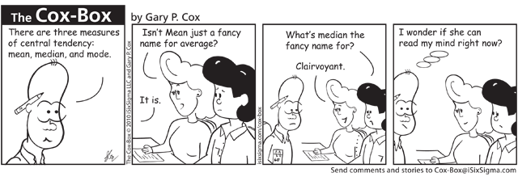
Central Measures
Part 4
Dr. Abolfazl Saghafi
Assistant Professor of Statistics & Data Science
Data Science Program Director

Slide 2
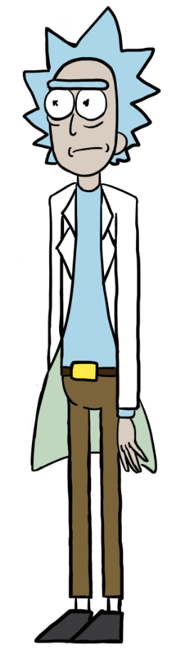

Common Central Measures
X
Variable of interest
Central Tendencies are inclinations or predispositions toward a central point
Population
of size N
Sample of size n
Mode
Median
Mean
Midrange
Weighted Mean
READ AS
X-ONE, X-TWO, ETC.
X1, X2, …, XN
n <= N
Observation 1 2 3 … n
Data values x₁ x₂ x₃ … xn
Example
Observation 1 2 3 4 5
Data values 5 7 3 38 7
Notes:
So we learned how we can describe data from a sample by using different graphs and tables, beside graphing a wide range of plots, we can compute some values which describe the data, besides comparing plots is subjective it requires experience, it is easier to compare numbers, together the plots and statistic helps us describe a dataset the best way we can
This chapter is devoted to some of these statistic, today we deal with the center of datasets
Once again, starting with a population of size N, lets say X is our variable of interest, it can be anything that is not constant among individuals of the population, it could be height age voting opinion, we show its measurement in population by X1 through XN

Slide 3
Mode
Observation 1 2 3 4 5
Data values 5 7 3 38 7
M = 7
The Mode is the value that occurs most frequently.
We shall denote the mode by the capital English letter M.
In small sample sizes, sort the data and easily find the Mode.
Ex. Find the Mode:
2 3 3 3 3 4 5 5 5 6 6 6 6 7 7 8
Ex. Find the Mode:
2 3 3 3 4 5 5 5 5 6 6 6 6 7 7 8
Notes:
A dataset could be bimodal or trimodal if there are more than one number with highest frequency. The first example is bimodal with 3 and 6 as the modes.
For consecutive numbers, the mode is defined as the average of the two consecutive numbers, unless the data type is qualitative, in that case you can still say it is bimodal. The second example is still unimodal with mode of 5.5. Looing at the histogram of the data reveals the mode of the distribution

Slide 4
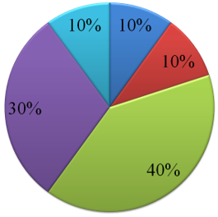

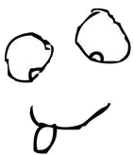

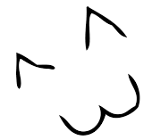

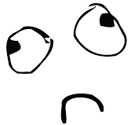
In listed data, the Mode is the class mark of the class with highest frequency. For example:
Outcome freq.
1 1
2 1
3 4⇦
4 3
5 1
In unlisted data, generate the frequency table. The Mode is the class mark of the most frequent class.
6.8 7.1 7.7 7.8 7.9 7.9 8.3 8.5 8.5 8.5 8.7 8.7 8.8 8.8 8.8 9.0 9.2 9.3 9.4 9.4 9.5 9.6 9.6 9.6 9.7 9.7 9.8 10 10.1 10.1 10.2 10.3 10.4 10.6 10.7 10.9 10.9 11.1 11.3 11.3 11 11.5 11.5 11.7 12 12.1 12.6 12.9 13 13.7
Freq
16
15
LCL | UCL | Class Mark | freq.
6.8 | 8.1 | 7.45 | 6
8.2 | 9.5 | 8.85 | 15
9.6 | 10.9 | 10.25 | 16
11.0 | 12.3 | 11.65 | 9
12.4 | 13.7 | 13.05 | 4
Sum |  |  | 50
9
6
4
7.45
8.85
10.25
11.65
13.05

Slide 5
Question
What is the Mode in the following examples?
Freq
Freq
16
16
16
14
14
10
9
6
6
4
4
7.45
8.85
10.25
11.65
13.05
7.45
8.85
10.25
11.65
13.05
Notes:
Left: Mode = (8.85+10.25)/2
Right: Modes = 8.85 and 11.65

Slide 6
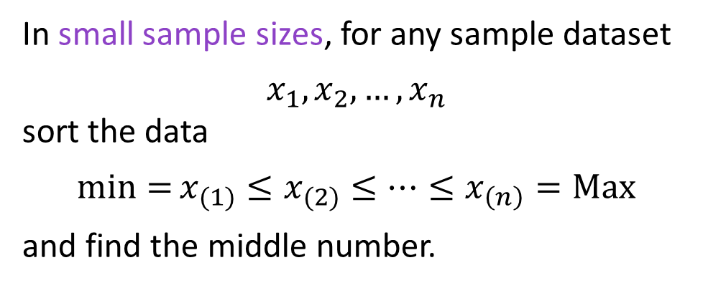
Median
If there is an odd number of data, then a single data point will be in the middle; namely the data value in the ((n+1)/2)^{th} position:
x₍₁₎ ≤ … ≤ x_{(n+1)/2} ≤ … ≤ x_{(n)}
⇧
m = x_{(n+1)/2}
The median is a value such that is greater than at least 50% of the data and less than at least 50%. We shall denote the median by lowercase letter m.
In small sample sizes, for any sample dataset
$$x_{1},x_{2},…,x_{n}$$
sort the data
$${\min{=}x}_{(1)}≤x_{(2)}≤…≤x_{\left(n\right)}=Max$$
and find the middle number.
For data sets with even sample size, median is the average of the data in the (n/2)^{th} position and the data in the (n/2 +1)^{th} position:
x₍₁₎ ≤ … ≤ x_{(n/2)} ≤ x_{(n/2+1)} … ≤ x_{(n)}
⇧
m = (x_{(n/2)} +x_{(n/2+1)} )/2
Observation 1 2 3 4 5
Data values 5 7 3 38 7
m = 7
Notes:
Sorted sample values $x_{1},x_{2},…,x_{n}$ from smallest to largest is shown by $x_{(1)},x_{(2)},…,x_{\left(n\right)}$ thereofore $x_{(1)}≤x_{(2)}≤…≤x_{\left(n\right)}$ where number in the parenthesis represent order after sorting

Slide 7
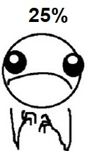




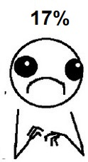

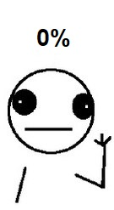

Examples
Ex3. Find the median of the pain scores without a calculator.
Find the median in the given cases:
Ex1.
2 3 3 3 4 4 5 5 6 6 6 7 7 7 8 9
Ex2.
2 3 3 3 4 5 5 6 6 6 7 7 8
Ex4.
LCL | UCL | Class Mark | Freq
6.8 | 8.1 | 7.45 | 6
8.2 | 9.5 | 8.85 | 15
9.6 | 10.9 | 10.25 | 16
11.0 | 12.3 | 11.65 | 9
12.4 | 13.7 | 13.05 | 4
Sum |  |  | 50
Notes:
Ex1. (5+6)/2= 5.5 Ex2. 5
Ex3. 50%
Ex4. 10.25 which is the class mark of the class with 25th and 26th observations

Slide 8



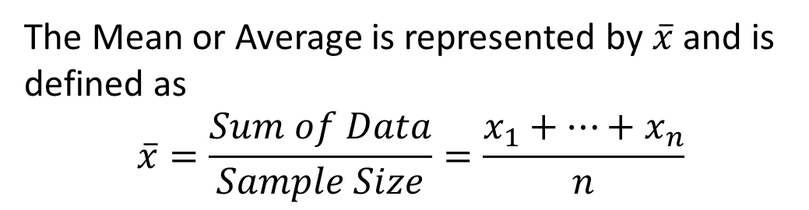
Mean or Average
Read as
x-bar
Observation 1 2 3 4 5
Data values 5 7 3 38 7
$\overline{x}$ = 12
The Mean or Average is represented by $\overline{x}$ and is defined as
$$\overline{x}=\frac{Sum of Data}{Sample Size}=\frac{x_{1}+…+x_{n}}{n}$$
Class
Mark
Class
Mark
freq.
$×$ freq.
In small sample sizes, simply add the data values and divide by their sample size.
In data presented by frequency tables with k classes, use:
$$\overline{x}=\frac{x_{1}f_{1}+x_{2}f_{2}+…+x_{k}f_{k}}{f_{1}+f_{2}+…+f_{k}}$$

Slide 9
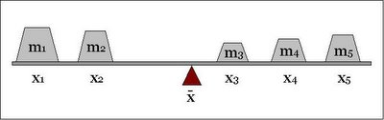
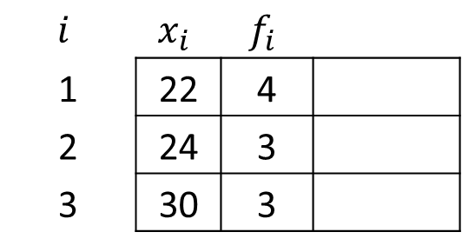
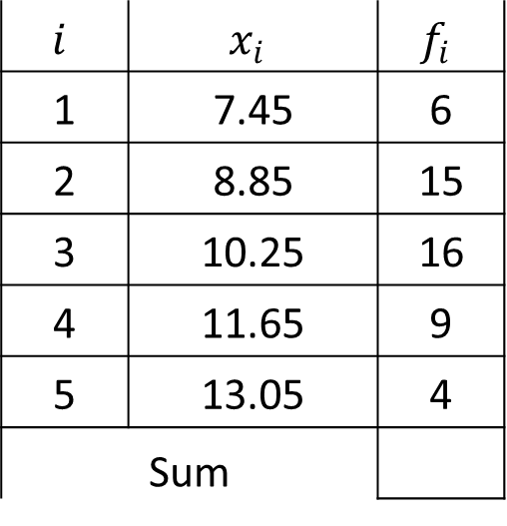
Examples
$$i$$ | $$x_{i}$$ | $$f_{i}$$
1 | 22 | 4
2 | 24 | 3
3 | 30 | 3
The mean is the pivot point of a frequency distribution.
Compute the mean
Freq
$$i$$ | $$x_{i}$$ | $$f_{i}$$
1 | 7.45 | 6
2 | 8.85 | 15
3 | 10.25 | 16
4 | 11.65 | 9
5 | 13.05 | 4
Sum
16
15
9
6
4
7.45
8.85
10.25
11.65
13.05
Notes:
Ex1. ((22*4)+(24*3)+(30*3))/(4+3+3)= 250/10= 25
Ex2. (7.45*56)+(8.85*15)+(10.25*16)+(11.65*9)+(13.05*4)= 498.5
xbar= 498.5/(6+15+16+9+4)=498.5/50= 9.97

Slide 10
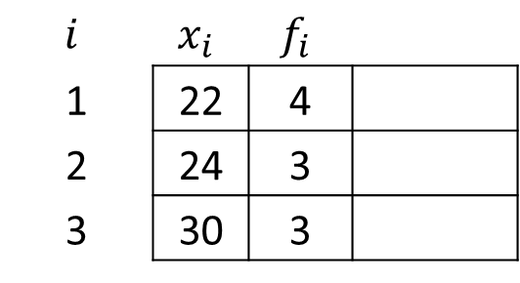
$$i$$ | $$x_{i}$$ | $$f_{i}$$
1 | 22 | 4
2 | 24 | 3
3 | 30 | 3
The mean is the pivot point of a frequency distribution.
Notes:
Ex1. ((22*4)+(24*3)+(30*3))/(4+3+3)= 250/10= 25
Ex2. (7.45*56)+(8.85*15)+(10.25*16)+(11.65*9)+(13.05*4)= 498.5
xbar= 498.5/(6+15+16+9+4)=498.5/50= 9.97

Slide 11
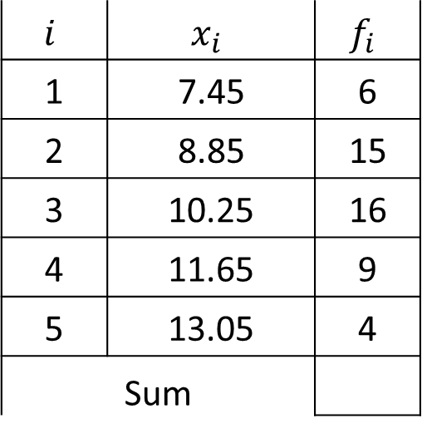
$$i$$ | $$x_{i}$$ | $$f_{i}$$
1 | 7.45 | 6
2 | 8.85 | 15
3 | 10.25 | 16
4 | 11.65 | 9
5 | 13.05 | 4
Sum
The mean is the pivot point of a frequency distribution.
Freq
16
15
9
6
4
7.45
8.85
10.25
11.65
13.05
Notes:
Ex1. ((22*4)+(24*3)+(30*3))/(4+3+3)= 250/10= 25
Ex2. (7.45*56)+(8.85*15)+(10.25*16)+(11.65*9)+(13.05*4)= 498.5
xbar= 498.5/(6+15+16+9+4)=498.5/50= 9.97

Slide 12
Which central tendency?
• Generally, the mean has the lowest error, variance, in a regular sample. It also considers all the data values and is proffered over mode and median
• When data is skewed, the median is preferred over the mean (or mode).
• For qualitative data Mode is the only central tendency that makes sense
Consider the wages of staff at a factory. Which central measure is a better representative?
Staff | 1 | 2 | 3 | 4 | 5 | 6 | 7 | 8 | 9 | 10
Salary | 15k | 18k | 16k | 14k | 15k | 15k | 12k | 17k | 90k | 95k
The mean salary for these ten staff is $30.7k
The median salary is $15.5k
The Mode salary is $15k
Overall, the value of the central measure should make sense, be around the center, after graphing the distribution of the data.
Notes:
Since this data is skrewed, median in a better central measure showing central wages

Slide 13
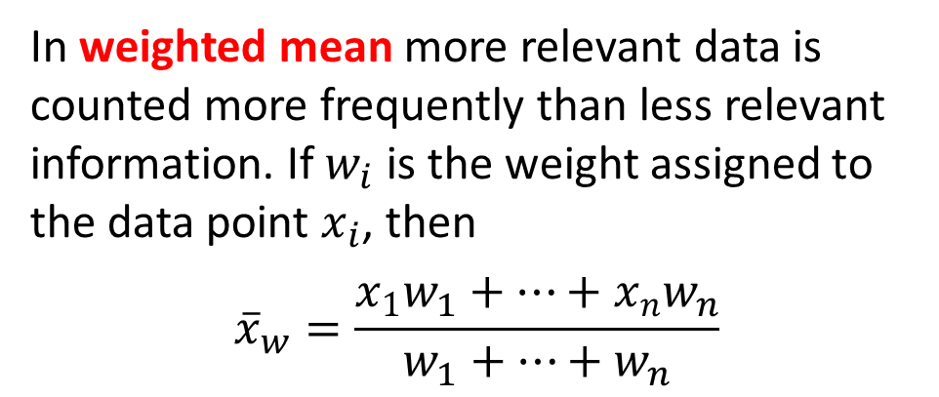
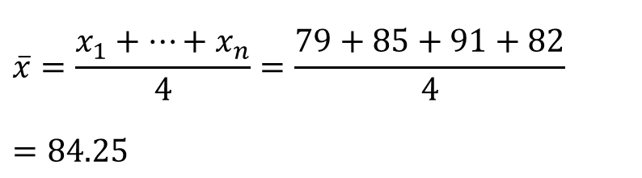
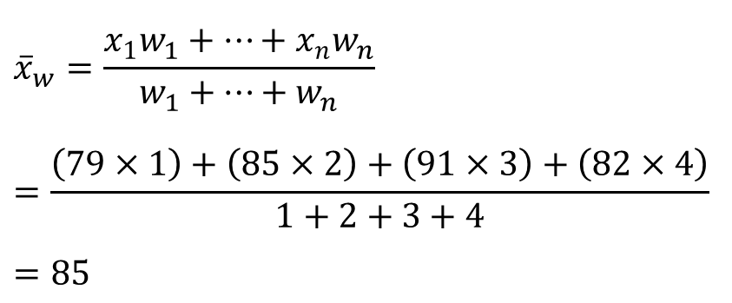
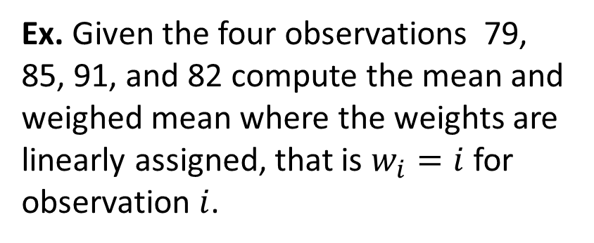
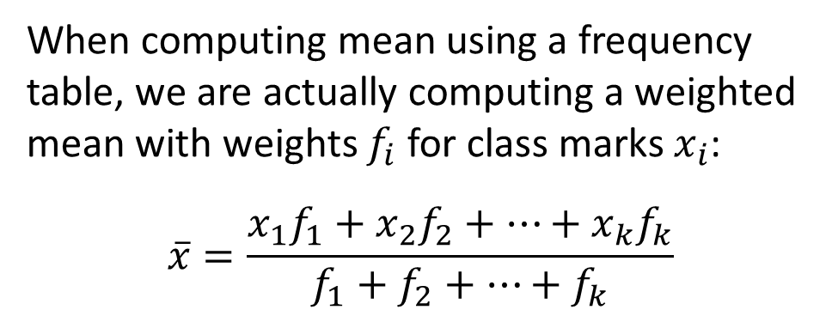
Weighted Mean
Ex. Given the four observations 79, 85, 91, and 82 compute the mean and weighed mean where the weights are linearly assigned, that is $w_{i}=i$ for observation $i$.
In weighted mean more relevant data is counted more frequently than less relevant information. If $w_{i}$ is the weight assigned to the data point $x_{i}$, then
$${\overline{x}}_{w}=\frac{x_{1}w_{1}+…+x_{n}w_{n}}{w_{1}+…+w_{n}}$$
$$\overline{x}=\frac{x_{1}+…+x_{n}}{4}=\frac{79+85+91+82}{4}$$
$$=84.25$$
When computing mean using a frequency table, we are actually computing a weighted mean with weights $f_{i}$ for class marks $x_{i}$:
$$\overline{x}=\frac{x_{1}f_{1}+x_{2}f_{2}+…+x_{k}f_{k}}{f_{1}+f_{2}+…+f_{k}}$$
$${\overline{x}}_{w}=\frac{x_{1}w_{1}+…+x_{n}w_{n}}{w_{1}+…+w_{n}}$$
$$=\frac{\left(79×1\right)+\left(85×2\right)+\left(91×3\right)+\left(82×4\right)}{1+2+3+4}$$
$$=85$$
Notes:
Your GPA is an example of a weighted mean where the number of credits are the weights for each grade

Slide 14
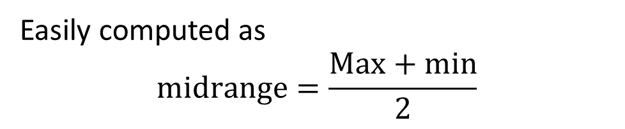
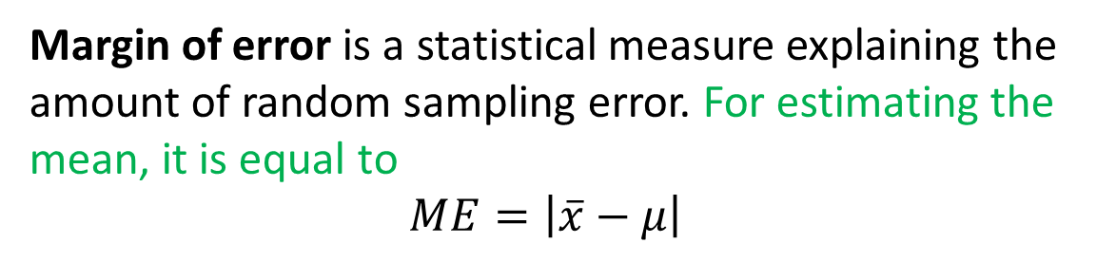
Midrange
Observation 1 2 3 4 5
Data values 5 7 3 38 7
midrange = 20.5
Easily computed as
$$midrange=\frac{Max+min}{2}$$
Ex. What is the value of midrange for
12 12 5 13 11 4 10 9
Margin of Error
Example: In a simulation, the mean is set to be 10. In a sample of simulated data, the sample mean is computed as 9.78, what is the margin of error?
Margin of error is a statistical measure explaining the amount of random sampling error. For estimating the mean, it is equal to
$$ME=\left|\overline{x}−μ\right|$$
Notes:
We are expecting that the sample mean to be close to the population mean, in general, that the statistic to be close to parameter, our estimation to be close to the actual value, BUT in never happens to be exactly the same number, because we are talking about two continuous entities, the chances that they get the same number is zero

Slide 15

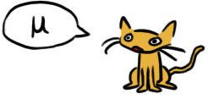
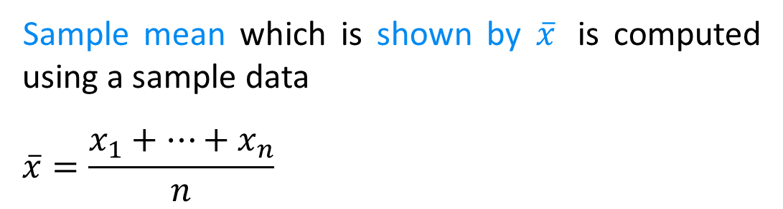
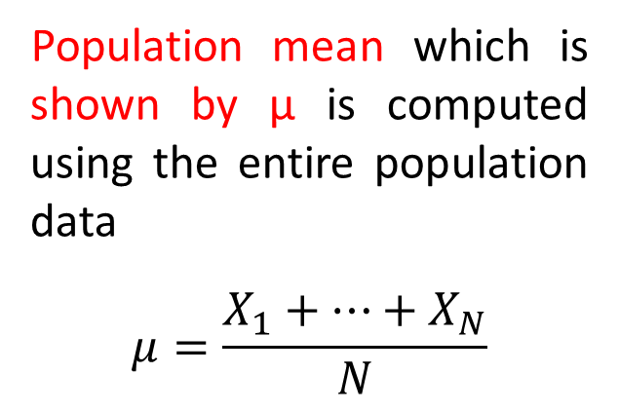
Sample Vs Population mean
Population
of size N
Sample of size n
Sample mean which is shown by $\overline{x}$ is computed using a sample data
$$\overline{x}=\frac{x_{1}+…+x_{n}}{n}$$
X1, X2, …, XN
n <= N
Remember this Morty! It’s REALLY important!!
Observation 1 2 3 … n
Data values x₁ x₂ x₃ … xn
Population mean which is shown by μ is computed using the entire population data
$$μ=\frac{X_{1}+…+X_{N}}{N}$$

Slide 16
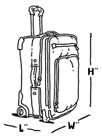
Exercise
The following numbers show a random sample of 13 airline carry-on luggage weights rounded to the nearest pound.
10 12 19 8 12 17 7 21 10 12 16 6 12
a) Compute the four central tendency measures.
b) Which of the measures seem to be a better representative of center? Explain.
c) Create a frequency table with four classes.
d) Compute the Mode, median, and mean using the frequency table and compare it to the former values. Which ones are more reliable?

Slide 17
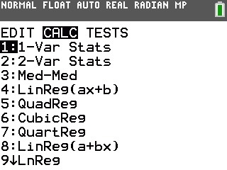
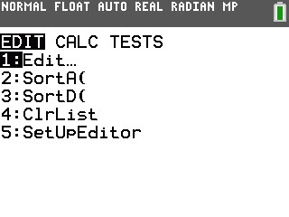
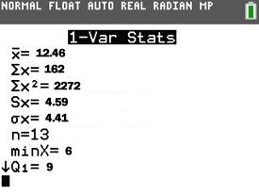
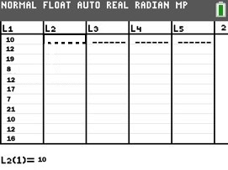
USING CALCULATOR
3. STAT > CALC
Select 1-Var Stats
L1
10
12
19
8
12
17
7
21
10
12
16
6
12
To compute ALL the central and spread measures.
1. STATS > EDIT
4. Assign Data
Hit OK
2. Enter Data
• Don’t enter anything for Freq.
• Pressing 2nd then 1 enters L1
2nd then 2 enters L2, etc.
Notes:
xbar= 12.46 m=12 M=12 Midrange=(6+21)/2=13.5
The data is slightly skew to the right, all three measures are close but median is the best central measure
Range=21-6=15 Tolerance=1
CW=Roundup(15/4)= 4
LCL1=6 UCL1=9 x1=7.5 f1=3
LCL2=10 UCL2=13 x2=11.5 f2=6
LCL3=14 UCL3=17 x3=15.5 f3=2
LCL4=18 UCL4=21 x4=19.5 f4=2
Using the table we have
xbar=12.42 m=11.5 M=11.5

Slide 18
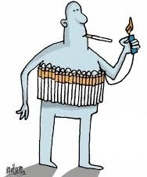
Practice Problems Part 4
1. The following table contains the nicotine content in milligrams (mg) per cigarette for 29 popular cigarette brands
a) Sort the nicotine content.
b) Compute four central tendency measures. Explain which one of the measures provides a better representation of center of the data.
c) Graph a boxplot to help you answer part b.
Do this first with a paper and pencil, then use your calculator and compare the results.
Notes:
Answers are provided in Ch2 Practice Problem Solutions

Slide 19
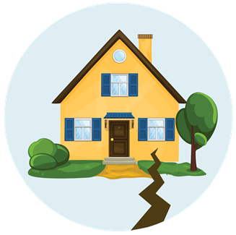
Practice Problems Part 4
2. The ages of females and males who died of sudden cardiac causes after 4:31 am on the day of the Northridge Earthquake are given below.
a) Construct a back-to-back stem and leaf plot of the data.
b) Compute the mean, median and mode separately for males and females. Which one is the best central measure for each gender?
Female | 77 | 83 | 75 | 77 | 70 | 80 | 68 | 58 | 70 | 81 | 78 | 69 | 38
Male | 90 | 38 | 45 | 47 | 79 | 75 | 71 | 68 | 51 | 55 | 66 | 56 | 59 | 60 | 68 | 64 | 53 | 90
Notes:
Answers are provided in Ch2 Practice Problem Solutions

Slide 20
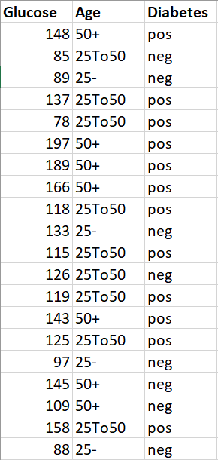
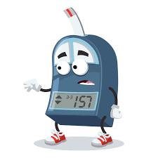
Practice Problems Part 4
2. The table shows information on Glucose level, Age group (25-, 25To50, 50+) and Diabetes status for a random sample of 20 patients.
a) Compute the mean, median and mode of Glucose.
b) Compute the mean, median and mode of Glucose separately for positive and negative diabetes status patients.
c) Compare the results from part a and b and make a reasonable conclusion.
Notes:
Answers are provided in Ch2 Practice Problem Solutions

